Slide 1
Chapter -04
Systems Analysis
Md. Manirujjaman

Slide 2
SYSTEMS PLANNING
THE INITIAL INVESTIGATION
INFORMATION GATHERING
THE TOOLS OF STRUCTURED ANALYSIS
FEASIBILITY STUDY
COST/BENEFIT ANALYSIS

Slide 3
Effective system development must begin with proper MIS planning, supported by management, because planning guides all phases of the system life cycle and is essential for successful system analysis, investigation, and implementation.

Slide 4
BASES FOR PLANNING IN SYSTEMS ANALYSIS
Information as a Resource: Information is a critical organizational asset, equal in importance to money, facilities, and personnel, and must be carefully planned and managed.
High Investment in Systems: Information systems require significant financial investment, demanding proper planning and management oversight.
Need for Long-Term Planning: Modern systems are complex, integrated, and long-term, requiring formal planning to align them with organizational goals and reduce isolated systems.

Slide 5
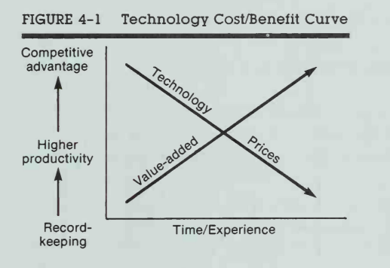
Business Conditions Influencing Systems Planning
High Interest Rates: Organizations must ensure a strong return on investment (ROI) from information systems.
Inflation Pressure: Rising costs reduce profits, making efficient and well-planned systems essential.
Fixed Employment Costs: Guaranteed employment increases fixed costs, limiting flexibility in expansion.
Resource Shortages: Limited resources restrict growth and require better utilization through systems
Carefully planned and well-used information systems move an organization from basic automation to higher productivity and competitive advantage at lower cost.
Notes:
Example: Enterprise Resource Planning (ERP) System for a Manufacturing Company
Imagine a garment manufacturing company in Bangladesh planning to implement an ERP system (for accounts, inventory, HR, production).
1. High Interest Rates:
Company needs a bank loan to buy ERP
High interest rate → loan is expensive
If we spend this money, will ERP help us earn or save MORE money than the loan cost?
If ERP saves more money than interest cost → investment is approved
2. Problem without system:
Manual planning → overproduction → waste → loss
ERP helps the company control costs when prices are rising
3. Fixed Employment Costs
ERP:Company grows without increasing staff cost
4. Resource Shortages :ERP:Growth happens by better use, not more resources
Core idea: Business conditions decide how information systems are designed, selected, and managed.

Slide 6
Strategic MIS Planning
Planning doesn't happen in a vacuum; it must align with the organization’s overall Master Plan.
Dimension 1: The Time Horizon (How far ahead?)
Short-Range: Less than 2 years (The immediate "Yearly Plan").
Medium-Term: 2 to 5 years (Building major modules).
Long-Range: More than 5 years (Conceptual, future-looking).
Dimension 2: The Focus (What is the goal?)
Strategic: Setting the big-picture objectives and policies.
Managerial: Coordinating resources and middle-management needs.
Operational: The daily "tactical" tasks and technical implementation.
Notes:
Planning doesn’t happen in a vacuum” means:
MIS planning must follow:
Business strategy
Organizational goals
Future direction

Slide 7
Need of system planning.
Information is a Strategic Asset: Data is now as valuable as cash or equipment. Planning ensures this "asset" is managed and protected properly.
Resource Management: IT projects require massive financial investment and specialized personnel. Planning prevents wasting these expensive resources.
System Integration: Modern systems are complex and share common databases. Planning ensures a new system "talks" to existing ones instead of being isolated.
Organizational Alignment: Planning ensures the system's goals match the company’s strategic business goals (congruency).
Standardization: It helps establish uniform hardware and software choices across the company, making maintenance easier and cheaper.

Slide 8
INITIAL INVESTIGATION
System development life cycle begins with Needs Identification, which is simply a User Request to fix or improve a system. Since companies get many requests, they use an Initial Investigation to "filter" them. The goal is to decide if a request is Valid and Feasible before spending money.
The Three Results:
Do Nothing: The problem isn't worth the cost.
Modify System: A quick fix to the current software.
Build New System: A complete replacement is needed

Slide 9
A User Request Form is the official document that identifies a need for change and authorizes an Initial Investigation. It typically includes these 9 key items:
Project Title: A simple name for the requested work.
Problem Definition: A description of the current issue (Nature of work).
Submission Date: When the request was filed.
Deadline: When the user expects the job to be finished.
Objectives: The specific purpose or goals of the request.
Expected Benefits: What the organization gains (e.g., cost savings, better speed).
Input/Output Details: The volume (pages/copies) and frequency (daily/weekly) of data.
Requester Info: Signature and contact details of the person asking for the change.
Approval Info: Signature and contact details of the manager authorizing the request.

Slide 10
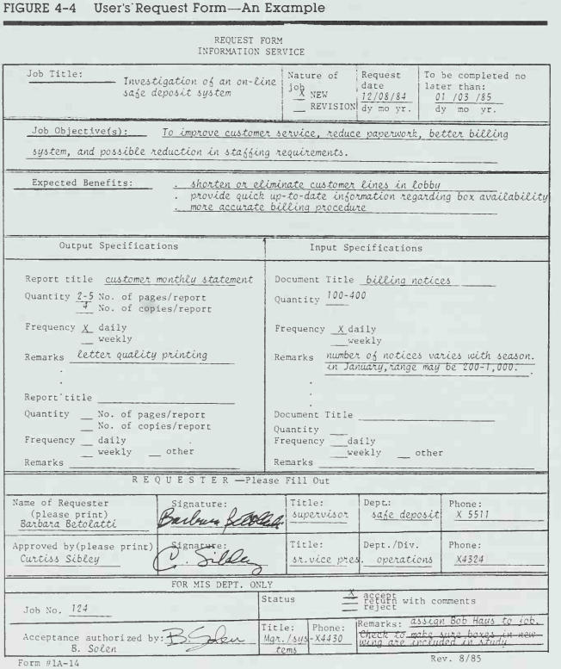

Slide 11
Needs Identification: Defining the Real Problem
Core Goal: The success of a system depends on accurately defining and investigating a problem before jumping to a solution.
Needs vs. Wants: The analyst focuses on what the user needs to function effectively, rather than just what they want (which may be unnecessary or incorrect).
Problem vs. Symptoms: This step helps the analyst find the real problem rather than just reacting to symptoms (the visible signs of the problem).

Slide 12
Why Determining Requirements is Difficult
Constant Change: System and user requirements are dynamic; they must be frequently modified to stay relevant.
Articulation Issues: Unless a user is highly experienced, it is difficult for them to describe complex functions and processes clearly.
Lack of Immediate Motivation: Users often lose interest because the "reward" (the working system) isn't seen until the final implementation phase.
Users think in qualitative terms (generalities and flexibility).

Slide 13
The Three Main Strategies - for determining information requirements:
The Three Main Strategies
Asking: The analyst simply asks users what they need. This works best for stable systems where users know exactly what they want.
Existing Systems: The analyst looks at current reports and data to see what is already there and what is missing.
Prototyping: A small version of the system is built first. Users try it out and then suggest changes based on their experience.

Slide 14
Factors for Choosing a Strategy
The best method depends on the Level of Uncertainty:
Low Uncertainty (Use "Asking"): Choose this when the requirements are stable and the user can easily explain them.
High Uncertainty (Use "Prototyping"): Choose this when it is hard to visualize the system or when needs are constantly changing.
Notes:
Low Uncertainty: requirements are clear and stable. Example
High Uncertainty: unclear, changing, or hard to imagine.
within one university system, some parts have low uncertainty and some have high uncertainty.
Low uncertainty → rules are fixed, already known, and rarely change,
Example: Result Processing System, Salary and Payroll System, Student Fee Payment System, Student Registration System
High uncertainty → human behavior, teaching style, or experience matters, and requirements are hard to define clearly
.Example-Lecture Management, Faculty Performance Evaluation System(teaching quality is subjective).
Is a Syllabus Management System Low or High Uncertainty?

Slide 15
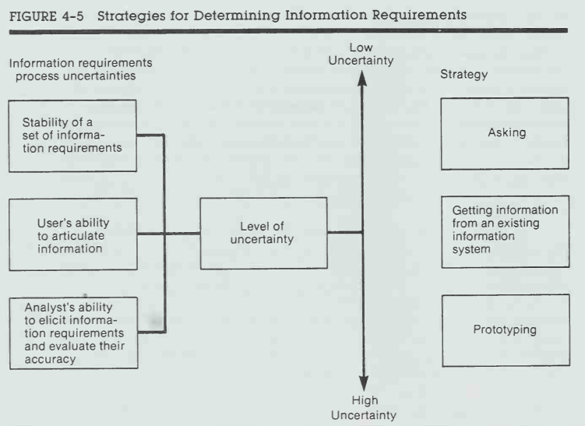

Slide 16
User Defensive Strategies (The "Predicament")
When users struggle to meet an analyst's technical expectations, they often adopt these strategies:
The Kitchen Sink: Requesting every possible report and feature out of fear of missing something (usually indicates inexperience).
The Smoking Screen: Requesting many features to use as "bargaining chips," knowing they only need one or two (indicates a savvy but cautious user).
The Same Thing: Asking for the exact current manual process but on a computer (indicates laziness or a lack of knowledge).
Notes:
When users cannot clearly explain their needs to a system analyst, they try to protect themselves. This protection is called user defensive strategies.

Slide 17
Human Limitations (Psychological Barriers)
Short-term Memory: Users only remember a few "important" things during an interview.
Recency Effect: Users give more weight to recent problems than those from the past.
Availability Bias: Users only ask for features based on the information they can see right now.
Bounded Rationality: Humans simplify complex problems because our brains have limited processing capacity.

Slide 18
Three Ways to "Ask"
Questions: Using open-ended questions for opinions or closed questions for facts.
Brainstorming: A group meeting to generate new or non-traditional ideas.
Group Consensus: Using a "Delphi" method where people answer questionnaires until everyone agrees, avoiding pressure from bosses.

Slide 19
The Goal of the Information Analyst
The Mission: To determine what the user needs (essential for the job) rather than what they want (nice to have).
The Process:
1. Ask what is currently available.
2. Identify what is missing.
3. Reach an agreement on what the new system will provide.
The Outcome: A "Logical Design" that serves as the foundation for the "Physical Design."

Slide 20
Fact Finding Tools :
Review of Written Documents: This involves examining official manuals, forms, and reports to understand how the system is designed to work.
On-site Observations: The analyst watches the work process in person to see how tasks are actually performed in the real-world environment.
Interviews: Direct conversations with users and staff to gather their specific requirements, opinions, and feelings about the system.
Questionnaires: A tool used to collect information from a large group of people efficiently

Slide 21
the tools of structured analysis
Review of Written Documents: Examining existing manuals, forms, and reports to understand how the system is currently designed to work.
On-site Observations: Watching the physical processes and person-to-person interactions to see how work is actually handled in the environment.
Interviews: Direct communication with users to gather specific requirements, feelings, and opinions.
Questionnaires: Distributing forms to collect data from a large group of people efficiently.
Organization Charts: Preparing a visual chart that lists functions and the people who perform them to understand the work environment and reporting structure.

Slide 22
Feasibility study:
Technical Feasibility Checks whether the required hardware, software, and technology are available and usable.
Economic Feasibility Examines whether the benefits of the system are greater than its costs.
Operational Feasibility Determines whether the system will work in the organization and be accepted by users.
Schedule (Time) Feasibility Evaluates whether the system can be completed within the required time frame.
Legal Feasibility Ensures the system does not violate laws, regulations, or company policies.

Slide 23
COST/BENEFIT ANALYSIS
Costs
Development Costs – Cost of designing and building the system.
Operating Costs – Day-to-day running costs of the system.
Fixed Costs – Costs that do not change with system usage.
Variable Costs – Costs that change based on system usage.
Direct Costs – Costs directly related to the system.
Indirect Costs – Costs not directly tied to the system but affected by it.

Slide 24
COST/BENEFIT ANALYSIS
Benefits
Tangible Benefits – Benefits that can be measured in money.
Intangible Benefits – Benefits that cannot be easily measured in money.
Direct Benefits – Benefits that result directly from the system.
Indirect Benefits – Secondary or long-term benefits of the system.
Evaluation Measures
Payback Period – Time needed to recover the investment.
Return on Investment (ROI) – Profit gained from the system compared to its cost.
Net Present Value (NPV) – Value of future benefits compared to current costs.

Slide 25
Thank You

